Slide 1
Introduction and Formation
Company: Meaning, nature and Kinds
Registration: advantages and disadvantages
Formation
Corporate veil.

Slide 2
NATURE AND CHARACTERISTICS OF A COMPANY
Since a corporate body (i.e. a company) is the creation of law, it is not a human being, it is an artificial juridical person (i.e. created by law);
It is clothed with many rights, obligations, powers and duties prescribed by law; it is called a ‘person’.
Being the creation of law, it possesses only the powers conferred upon it by its Memorandum of Association which is the charter of the company.
Within the limits of powers conferred by the charter, it can do all acts as a natural person may do.

Slide 3
Features of a Company
Corporate Personality
Company as a Person - It is capable of enjoying rights and being subject to duties. Ex: to sue as an indigent person, etc.
Limited liability and exception
Perpetual succession
Separate property - a shareholder does not, as is erroneously believed by some people, become the part owner of the company or its property
Common seal
Sue and be sued – to institute a legal suit
Contractual rights
Limitations of Actions – Ultra Vires
Voluntary Association for Profits
Termination of existence

Slide 4
The most striking characteristics of a company are :
Corporate Personality:
A company incorporated under the Act is vested with a corporate personality so it redundant
bears its own name,
acts under name,
has a seal of its own and
its assets are separate and distinct from those of its members.
It is a different ‘person’ from the members who compose it.
Therefore it is capable of
owning property,
incurring debts,
borrowing money,
having a bank account,
employing people,
entering into contracts and
suing or being sued in the same manner as an individual.
A shareholder cannot be held liable for the acts of the company even if he holds virtually the entire share capital.

Slide 5
The shareholders are not the agents of the company and so they cannot bind it by their acts.
The company does not hold its property as an agent or trustee for its members and they cannot sue to enforce its rights, nor can they be sued in respect of its liabilities.
Thus, ‘incorporation’ is the act of forming a legal corporation as a juristic person. A juristic person is in law also conferred with rights and obligations and is dealt with in accordance with law. In other words, the entity acts like a natural person but only through a designated person, whose acts are processed within the ambit of law [Shiromani Gurdwara Prabandhak Committee v. Shri Sam Nath Dass, 2000].

Slide 6
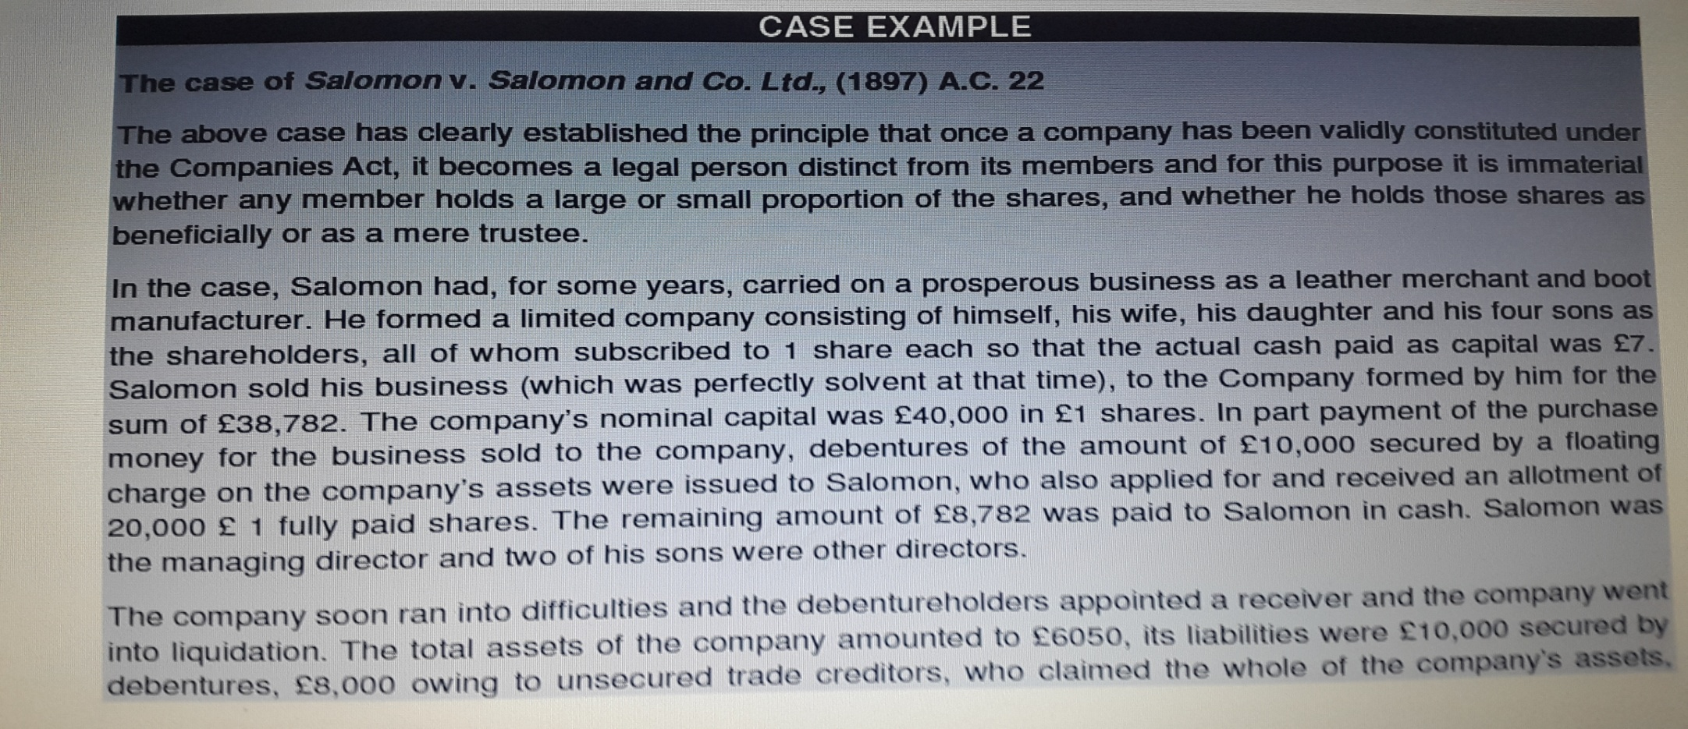

Slide 7
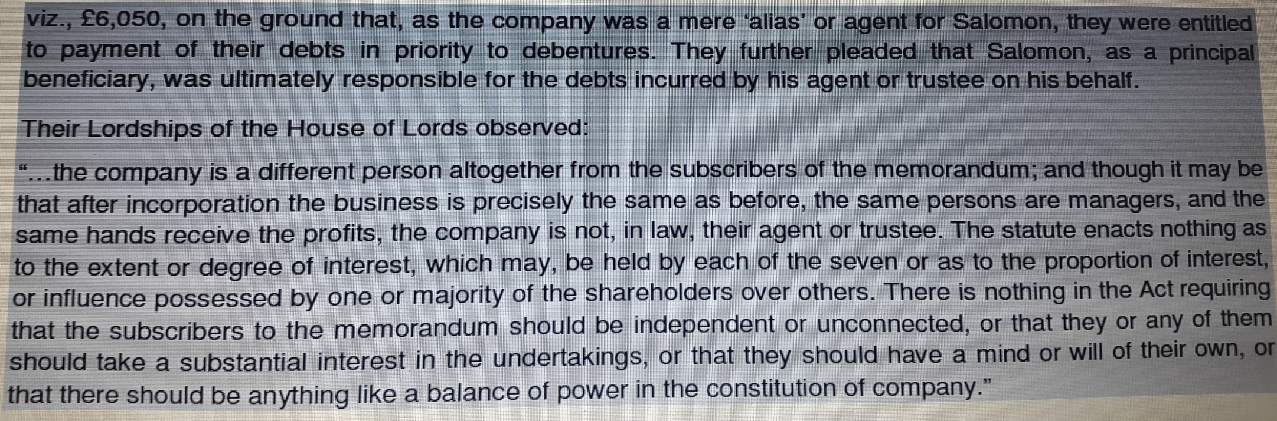

Slide 8
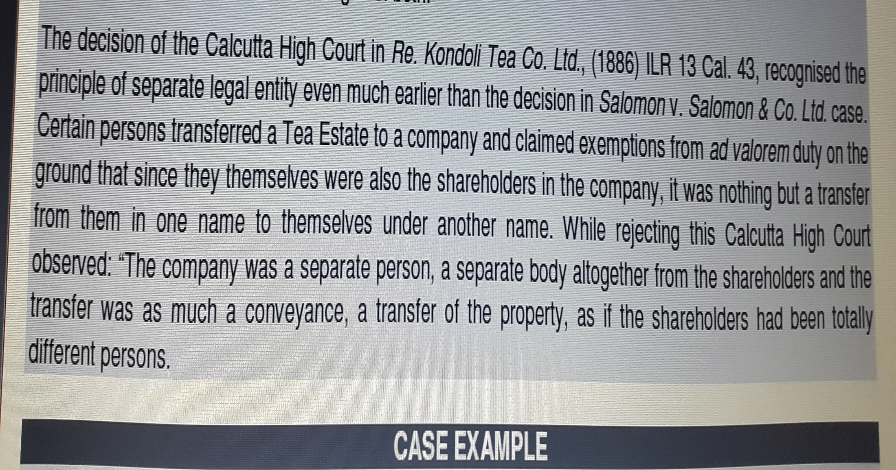
Examples of Cases:

Slide 9
Company as a Person
A Company is an artificial person created by law.
It is not a human being but it acts through human beings.
It is considered as a legal person which can enter into contracts, possess properties in its own name, sue and can be sued by others etc.
It is called an artificial person since it is invisible, intangible, existing only in the contemplation of law.
It is capable of enjoying rights and being subject to duties.

Slide 10
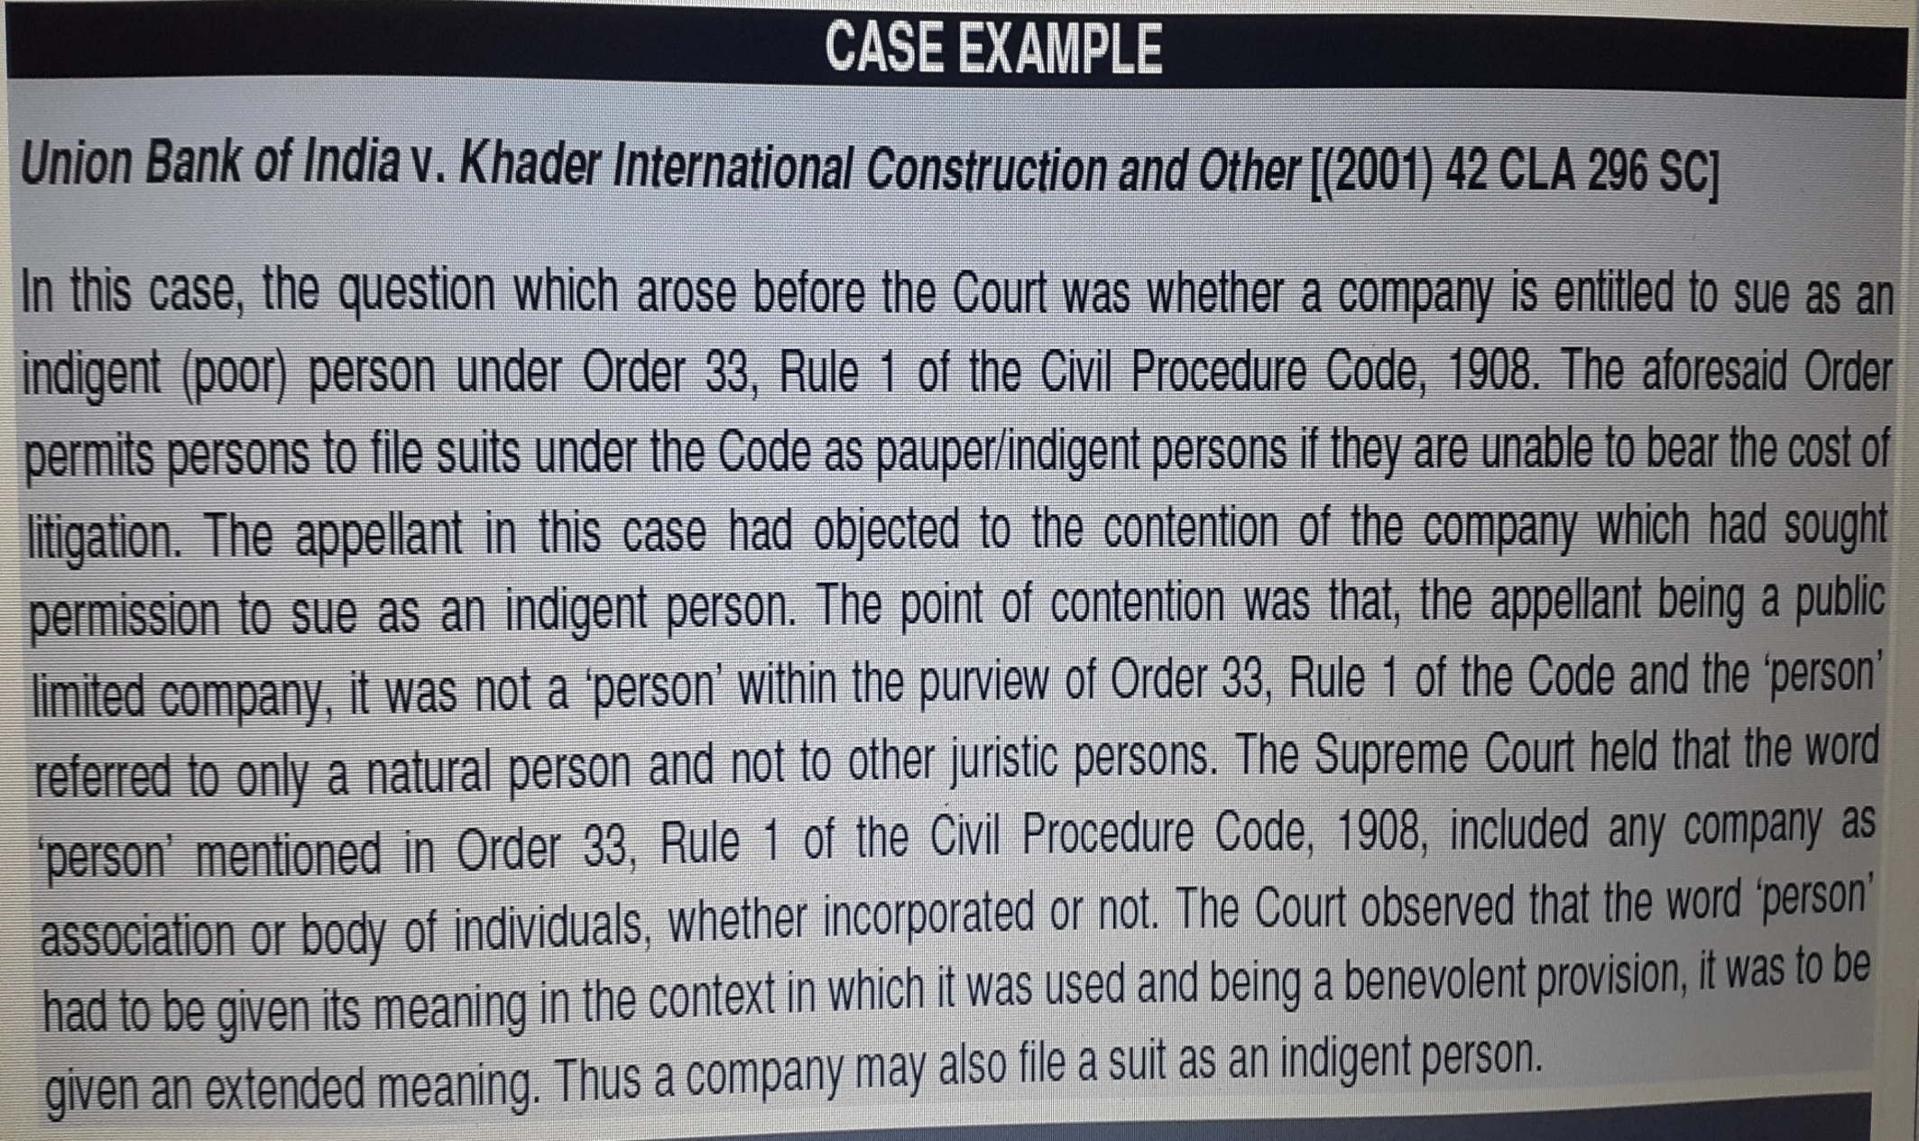
Company’s right to sue as an indigent person

Slide 11
Limited Liability
“The privilege of limited liability for business debts is one of the principal advantages of doing business under the corporate form of organization.”
The company, being a separate person, is the owner of its assets and bound by its liabilities. The liability of a member as shareholder, extends to the contribution to the capital of the company up to the nominal value of the shares held and not paid by him.
Members, even as a whole, are neither the owners of the company’s undertakings, nor liable for its debts. In other words, a shareholder is liable to pay the balance, if any, due on the shares held by him, when called upon to pay and nothing more, even if the liabilities of the company far exceed its assets. This means that the liability of a member is limited.

Slide 12
3.1 Exceptions to the principle of limited liability
Where a company has been got incorporated by furnishing any false or incorrect information or representation or by suppressing any material fact or information in any of the documents or declaration filed or made for incorporating such company or by any fraudulent action
where in the course of winding up it appears that any business of the company has been carried on with an intent to defraud creditors of the company or any other persons or for any fraudulent purpose
When the company is incorporated as an Unlimited Company
Where it is proved that a prospectus has been issued with intent to defraud the applicants for the securities of a company or any other person or for any fraudulent purpose, every person who was a director at the time of issue of the prospectus or has been named as a director in the prospectus or every person who has authorized the issue of prospectus or every promoter or a person referred to as an expert in the prospectus shall be personally responsible, without any limitation of liability, for all or any of the losses or damages that may have been incurred by any person who subscribed to the securities on the basis of such prospectus

Slide 13
Perpetual Succession:
An incorporated company never dies, except when it is wound up as per law. A company, being a separate legal person is unaffected by death or departure of any member and it remains the same entity, despite total change in the membership.
A company’s life is determined by the terms of its Memorandum of Association. It may be perpetual, or it may continue for a specified time to carry on a task or object as laid down in the Memorandum of Association.
Perpetual succession, therefore, means that the membership of a company may keep changing from time to time, but that shall not affect its continuity. The membership of an incorporated company may change either because one shareholder has sold/transferred his shares to another or his shares devolve on his legal representatives on his death or he ceases to be a member under some other provisions of the Companies Act.
Thus, perpetual succession denotes the ability of a company to maintain its existence by the succession of new individuals who step into the shoes of those who cease to be members of the company.

Slide 14
Separate Property :
A company being a legal person and entirely distinct from its members, is capable of owning, enjoying and disposing of property in its own name.
The company is the real person in which all its property is vested, and by which it is controlled, managed and disposed off.
Their Lordships of the Madras High Court in R.F. Perumal v. H. John Deavin, A.I.R. 1960 Mad. 43 held that “no member can claim himself to be the owner of the company’s property during its existence or in its winding-up”.

Slide 15
CASE LAW
Mrs. Bacha F. Guzdar v. The Commissioner of Income Tax, Bombay, A.I.R. 1955 S.C. 74
It was observed by the Supreme Court that a shareholder does not, as is erroneously believed by some people, become the part owner of the company or its property;
He is only given certain rights by law, e.g., to receive notice of or to attend or vote at the meetings of the shareholders.
The court refused to identify the shareholders with the company and reiterated the distinct personality of the company.

Slide 16
Transferability of Shares:
The capital of a company is divided into parts, called shares.
The shares are said to be movable property and, subject to certain conditions, freely transferable, so that no shareholder is permanently or necessarily wedded to a company.
When the joint stock companies were established, the object was that their shares should be capable of being easily transferred, [In Re. Balia and San Francisco Rly., (1968)].
Section 44 of the Companies Act, 2013 enunciates the principle by providing that the shares held by the members are movable property and can be transferred from one person to another in the manner provided by the articles (AOA).
A member may sell his shares in the open market and realize the money invested by him. This provides liquidity to a member (as he can freely sell his shares) and ensures stability to the company (as the member is not withdrawing his money from the company).
The Stock Exchanges provide adequate facilities for the sale and purchase of shares.

Slide 17
Common Seal:
Upon incorporation, a company becomes a legal entity with perpetual succession and a common seal. Since the company has no physical existence, it must act through its agents and all contracts entered into by its agents must be under the seal of the company.
The Common Seal acts as the official signature of a company. The name of the company must be engraved on its common seal. A rubber stamp does not serve the purpose.
A document not bearing common seal of the company, when the resolution passed by the Board, for its execution requires the common seal to be affixed is not authentic and shall have no legal force behind it. However, a person duly authorised to execute documents pursuant to a power of attorney granted in his favour under the common seal of the company may execute such documents and it is not necessary for the common seal to be affixed to such documents.
The person, authorised to use the seal, should ensure that it is kept under his personal custody and is used very carefully because any deed, instrument or a document to which seal is improperly or fraudulently affixed will involve the company in legal action and litigation.

Slide 18
8. Capacity to Sue and Be Sued :
A company being a body corporate, can sue and be sued in its own name.
To sue, means to institute legal proceedings against (a person) or to bring a suit in a court of law. All legal proceedings against the company are to be instituted in its name. Similarly, the company may bring an action against anyone in its own name.
A company, as a person distinct from its members, may even sue one of its own members.

Slide 19
Contractual Rights :
A company, being a legal entity different from its members, can enter into contracts for the conduct of the business in its own name.
A shareholder cannot enforce a contract made by his company; he is neither a party to the contract, nor be entitled to the benefit derived from of it
Likewise, a shareholder cannot be sued on contracts made by his company.
Therefore, the company as a legal person can take action to enforce its legal rights or be sued for breach of its legal duties. Its rights and duties are distinct from those of its constituent members.

Slide 20
Limitation of Action:
A company cannot go beyond the power stated in its MOA.
The MOA of the company regulates the powers and fixes the objects of the company and provides the edifice (structure) upon which the entire structure of the company rests.
The actions and objects of the company are limited within the scope of its MOA. In order to enable it to carry out its actions without such restrictions and limitations in most cases, sufficient powers are granted in the MOA. But once the powers have been laid down, it cannot go beyond such powers unless the MOA, itself altered prior to doing so

Slide 21
Separate Management:
As already noted, the members may derive profits without being burdened with the management of the company.
They do not have effective and intimate control over its working and they elect their representatives as Directors on the Board of Directors of the company to conduct corporate functions through managerial personnel employed by them.
In other words, the company is administered and managed by its managerial personnel.

Slide 22
12. Voluntary Association for Profit:
A company is a voluntary association for profit.
It is formed for the accomplishment of some stated goals and whatsoever profit is gained is divided among its shareholders or saved for the future expansion of the company.
Termination of Existence:
A company, being an artificial juridical person, does not die a natural death. It is created by law, carries on its affairs according to law throughout its life and ultimately is effaced by law.
Generally, the existence of a company is terminated by means of winding up. However, to avoid winding up, sometimes companies adopt strategies like reorganization, reconstruction and amalgamation.
To sum up, “a company is a voluntary association for profit with capital divisible into transferable shares with limited liability, having a distinct corporate entity and a common seal with perpetual succession”.

Slide 23
Memorandum of Association
The Memorandum of Association is the charter of a company. It is a document, which amongst other things, defines the area within which the company can operate.
A Company cannot be registered without MOA
Contains the fundamental conditions on which alone it can be incorporated.
Generally it cannot be altered
The company is incorporated only for the objects given in MOA
Confines the power of the company.
The contents or clauses described as condition of Co’s incorporation
The name clause
Registered office clause
Object clause
Liability clause
Capital clause
Association & subscription clause

Slide 24
1. NAME CLAUSE
State the name of the proposed company
End with ‘limited’ or ‘private limited’
Should not be similar or identical with already registered
As of now, the law appears to be settled that a well-known trademark cannot be used by unrelated companies for different products.
However, in some cases the so called well known TM may have become as such after the other party has started using it prior its registration by the company.
In such cases depending on the facts and circumstances of the case, such parties may be permitted to continue the usage of the same. The problem arises because of no compulsion to register a TM.
Because of inadvertence (unintentional omission) if a company is registered by an already registered one then,
Change the name by passing ordinary resolution with central government approval
The registrar then can enter the new name & issue a fresh incorporation certificate.

Slide 25
Some examples
M/s. M. Dyechem Ltd. Vs. M/s. Cadbury (India) Ltd.
“…word 'PIKNIK' could not be compared to cases where well known trade names were under use - like Cadbury PICNIC”

Slide 26
Some examples
Raymond Limited vs Raymond Pharmaceuticals, 2010
Bombay High Court has ordered Raymond, the textile company of the Singhania group, to share its trademark "Raymond" with a Chennai-based privately-held pharmaceutical company Raymond Pharmaceuticals. Mumbai-based Raymond had approached the Bombay High Court in 2006 against the use of its registered trademark "Raymond" by the pharma firm, alleging that the pharma company had infringed its trademark.
But the division bench of Justices DK Deshmukh and RP Sondurbalodta on July 13 observed, "if the defendant (Raymond Pharmaceuticals ) uses the registered trademark as a part of its trade name, but does not deal in the same goods in respect of which the trademark is registered (by Raymond Limited), then it does not amount to infringement for the purpose of Trademark Act.“

Slide 27
Even when the products of both companies are dissimilar, there is an infringement as one company enjoys undue advantage of the reputation of the registered trademark. This will lead to loss of distinction of the trademark, submitted Raymond Ltd's counsels. However, Raymond Pharmaceutical counsel Manish Saurastri argued that the use of a trademark is not an infringement if both companies deal with dissimilar goods and services. Also, the pharmaceutical company was only using "Raymond" as a business name and not as a trademark to promote its goods and services, he contended.
Mr Saurastri told ET that this judgement sets right the controversy of mutual exclusiveness of Sections 29(4) and 29(5) of the Trademark Act, 1999 where the registered trademark is used as part of the corporate name.
The provisions of Section 29(4) are regarding usage of trademark that "passes off" or is "similar" to that registered by another company and used for unfair advantage of, or detrimental to the distinctive reputation of that company.

Slide 28
2. REGISTERED OFFICE
Specify the state in which the registered office will be situated
No need to give the name of the city and the exact address in this clause
Can shift within the same city, town or village
If within the same state then pass a Special Resolution and give a notice to the registrar within 30 days communicating the address.
Different States-
File the copy of NCLT order with the registrar of both states.
All other documents of the company to the other state registrar.

Slide 29
3. OBJECT CLAUSE
2013 Act has only object clause and not divided into any subclauses.
- To make changes - if special resolution is not passed, then an application should be made by BOD & the Central Govt. may allow new business in other objects
- provided the votes cast in favour of the resolution exceeds against

Slide 30
Objects clause (2013 Act)
a. The objects to be pursued by the company on its incorporation
b. Matters which are necessary for furtherance of the objects specified in clause

Slide 31
The object clause of the Memorandum of the company contains the object for which the company is formed.
An act of the company must not be beyond the objects clause, otherwise it will be ultravires
and,
therefore, void and cannot be ratified even if all the members wish to ratify it. This is called the doctrine of ultra vires, which has been firmly established in the case of
Ashbury Railway Carriage and Iron Company Ltd v. Riche.

Slide 32
The expression “ultra vires” consists of two words:
‘ultra’ and ‘vires’ – ‘Ultra’ means beyond and ‘Vires’ means powers.
Which means beyond the powers – those powers as mentioned in MOA’s object clause.

Slide 33
Protection Of Creditors And Investors
developed to protect the investors and creditors of the company.
prevents a company to employ the money of the investors for a purpose other than those stated in the objects clause of its memorandum.
Thus, the investors and the company may be assured by this rule that
their investment will not be employed for the objects or activities which they did not have in contemplation at the time of investing their money in the company.
It enables the investors to know the objects in which their money is to be employed.
protects the creditors of the company by ensuring them that the funds of the company to which they must look for payment are not dissipated in unauthorized activities.
The wrongful application of the company’s assets may result in the insolvency of the company, a situation when the creditors of the company cannot be paid.

Slide 34
In this case, the objects of the company as stated in the objects clause of its memorandum, were
‘to make and sell, or lend on hire railway carriages and wagons, and all kinds of railway plaint, fittings, machinery and rolling stock to carry on the business of mechanical engineers and general contractors to purchase and sell as merchants timber, coal, metal or other materials;
and to buy and sell any materials on commissions or as agents’.

Slide 35
The directors of the company entered into a contract with M/s. Riche, a firm of railway contractors to finance the construction of a railway line in Belgium.
The contract was ratified by all the members of the company, but later on it was repudiated by the company.
On subsequent repudiation of this contract by the company on the ground of its being ultra vires, Riche brought a case for damages on the ground of breach of contract, as according to him the words “general contractors” in the objects clause gave power to the company to enter into such a contract and, therefore, it was within the powers of the company.
More so because the contract was ratified by a majority of shareholders.

Slide 36
Issue
whether the contract was valid
and
whether the contract could be ratified / approved by the members of the company?

Slide 37
It was held that:
(a) The contract was beyond the objects as defined in the objects clause of its memorandum and, therefore it was void,
(b) The company had no capacity to ratify the contract.
Relevant Case law: Ashbury Railway Carriage and Iron Company Ltd v. Riche, (1875)

Slide 38
DECISION
contract is void in its inception
it is void because the company had no capacity to make contract and since the company lacks the capacity to make such contract, how it can have capacity to ratify it.
If the shareholders are permitted to ratify an ultra vires act or contract, it will be nothing but permitting them to do the very thing which, by the Act of Parliament, they are prohibited from doing.

Slide 39
The House of Lords has expressed the view that –
a company incorporated under the Companies Act has power to do only those things which are authorized by its objects clause of its memorandum
The term ‘general contractor’ was interpreted to indicate as the making generally of such contracts as are connected with the business of mechanical engineers
And anything not so authorized is ultra vires the company and cannot be ratified or made effective even by the unanimous agreement of the members.

Slide 40
In A. Lakshmanaswami Mudaliar v. L.I.C., 1963
Upheld the doctrine of ultra vires.
In this case, the directors of the company were authorised “to make payments towards any charitable or any benevolent object or for any general public or useful object”.
In accordance with shareholders’ resolution the directors paid Rupees 2 lakhs to a trust formed for the purpose of promoting technical and business knowledge.
The company’s business having been taken over by L.I.C., it had no business left of its own

Slide 41
The Supreme Court held that the payment was ultra vires the company.
Directors could not spend company’s money on any charitable or general objects.
They could spend for the promotion of only such charitable objects as would be useful for the attainment of the company’s own objects.
It is pertinent to add that the powers vested in the Board of directors, e.g., power to borrow money, is not an object of the company.
The powers must be exercised to promote the company’s objects.
Charity is allowed only to the extent to which it is necessary in the reasonable management of the affairs of the company.
Justice Shah held:
“There must be proximate connection between the gift and the company’s business interest”.
Thus if,
“gifts to foster research relevant to the company’s activities” and “payments to widows of ex-employees on the footing that such payments encourage persons to enter the employment of the company” will be upheld as valid and intra vires.

Slide 42
Corporate bona fide charitable spending under Section 181 and ultra vires rule
Section 181 of the Companies Act, 2013 authorizes the Board of directors to contribute to bona fide charitable and other funds.
However, prior consent of the company in general meeting, has to be obtained in order to
contribute for any bona fide charitable or other purpose any amount exceeding five per cent of the average net profits for the three immediately preceding financial years.
The power of the Board as regards contribution to funds, which do directly relate to business of the company is unrestricted.
It should not be inferred from the language of the section that with the consent of the company in general meeting, the board of directors may contribute to charitable funds to an unlimited extent, unless MoA and AoA authorizes such expenditure.
If it does not authorize so, it will be ultra vires the powers of the company

Slide 43
Doctrine of Constructive Notice
The MOA and AOA on registration assumes the character of public documents.
The office of the registrar is a public office and documents registered there are open and accessible to the public at large.
Therefore, every outsider dealing with the company under various contracts is deemed to have notice of the contents of the MOA and AOA, whether he reads it or not.
This is known as Constructive Notice of MOA & AOA.

Slide 44
Every person who contemplates / thinks entering into a contract with a company, has the means of ascertaining and consequently,
presumed to know, not only the exact powers of the company but also to the extent to which these powers have been delegated to the directors and of any limitation placed upon the exercise of these powers.
Every person dealing with the company is deemed to have a constructive notice of the contents of its MOA and AOA.
Because
The memorandum and articles, when registered, become public documents and
Can be inspected by any member of the public at the office of the RoC on payment of a nominal fee

Slide 45
But
Its objects and powers are set out in the memorandum and articles of association which is amended from time to time.

Slide 46
Hence, if a person enters into a contract which is beyond the powers of the company, as defined in the memorandum, he cannot acquire any rights under the contract against the company.
This rule proved to be too inconvenient for business transactions and hindered the smooth flow of business.
The rigours of the rule was, therefore, alleviated / eased by the judicial pronouncement in Royal British Bank v Turquand, and the doctrine of ‘indoor management’ serving as an exception to the doctrine of ‘constructive notice’

Slide 47
Doctrine of Indoor Management
According to this doctrine, as laid down in the Royal British Bank case (Turquand’s rule), persons dealing with a company are not bound to inquire into the regularity of any internal proceedings.
In other words, while persons contract with a company they are entitled to assume that the provisions of the Articles have been observed by the officers of the company.
It is no part of the duty of an outsider to see that the company carries out its own internal regulations.
It is sufficient if the act is not ultra vires.
the rule is that persons dealing with limited liability companies are not bound to enquire into their indoor management and will not be affected by irregularities of which they had no notice

Slide 48
The doctrine of constructive notice of a company's public documents was abolished prospectively as expected.
While the doctrine of constructive notice seeks to protect the company against the outsiders
the principle of indoor management operates to protect the outsiders while dealing with the company.

Slide 49
4. LIABILITY CLAUSE
States the liability of members whether limited / unlimited
A change can be brought by special resolution

Slide 50
5. CAPITAL CLAUSE
This is the fifth compulsory clause which must state the amount of the capital with which the company is registered.

Slide 51
6. ASSOCIATION AND SUBSCRIPTION CLAUSE
A declaration
Signatures of subscribers of memorandum
Subscribed by atleast 7 in pub and 2 in pvt.
A subscriber must take atleast 1 share & cannot withdraw on any ground

Slide 52
ARTICLES OF ASSOCIATION
are the bye laws
governs the internal management
prescribes regulations for attainment of objects of MOA
as MOA restricts the action of a company, the AOA makes regulations for own management as they think fit.
AOA constitutes a contract between the company and members.
defines rights and duties
it is not related with outsiders

Slide 53
CONTENTS OF AOA
directors, their qualification, remuneration
board meetings
define imp. words and phrases
cap. clause – specify the classes into which the division of share cap. is done.
define rights of all classes – voting, bonuses
allotment of shares
fixing min. subscription
share certificates & warrants
transfer of shares
increase or decrease of cap.
the consolidation and subdivision of shares
gen. meet, proceedings
total, partial or exclusion of table – a, (pub cos. having share cap.)
audit a/c’s
common seal
notices
special provisions for winding up
arbitration

Slide 54
DIFFERENCE BETWEEN MOA & AOA
AOA
Are internal regulations of co.
Benefit of shareholders
Regulations are for their own management
MOA
Contains fundamental conditions
Only on this the co. can be incorporated
The conditions are for the benefit of public, shareholders, creditors
Limits the powers of the co.

Slide 55
Kinds of Companies

Slide 56
Types of companies
Types of companies that can be formed under 2013 Act has remained same as in 1956 Act, except one more class of company has been added.

Slide 57
The Companies Act, 2013 provides for the kinds of companies that can be promoted and registered under the Act. The three basic types of companies which may be registered under the Act are:
Private Companies;
Public Companies; and
One Person Company (to be formed as Private Limited)..

Slide 58
Types of Companies under Section 3 (1) of The Companies Act, 2013
Public Company
Min. Paid up share capital of INR 5 Lakh
7 – unlimited members
Any subsidiary of public company shall be treated as public company even if such subsidiary company has obtained the status of a private company in its articles
Private company
Minimum paid up share capital of INR 1 Lakh
2 or more persons can form a private company subject to a limit of maximum 200 members except in the case of one person company
Right to transfer its shares is restricted
One Person Company
to be formed as Private limited Company
Only one person as Member
All of the above may be either –
(a) A company limited by share; or
(b) A company limited by guarantee; or
(c) An unlimited company

Slide 59
Classification of Companies
There are three ways in which companies may be incorporated.

Slide 60
(i) Classification on the basis of Incorporation
Statutory Companies:
These are constituted by a special Act of Parliament or State Legislature. The provisions of the Companies Act, 2013 do not apply to them.
Examples: Reserve Bank of India, Life Insurance Corporation of India, etc.
(b) Registered Companies:
The companies which are incorporated under the Companies Act, 2013 or under any previous company law, with ROC fall under this category.

Slide 61
(ii) Classification on the basis of Liability
Unlimited Liability Companies:
In this type of company, the members are liable for the company's debts in proportion to their respective interests in the company and their liability is unlimited.
Companies limited by guarantee:
A company that has the liability of its members limited to such amount as the members may respectively undertake, by the memorandum, to contribute to the assets of the company in the event of its being wound-up, is known as a company limited by guarantee. The members of a guarantee company are, in effect, placed in the position of guarantors of the company's debts up to the agreed amount.
Companies limited by shares:
A company that has the liability of its members limited by the memorandum to the amount, if any, unpaid on the shares respectively held by them is termed as a company limited by shares.
For example:
A shareholder who has paid Rs. 75 on a share of face value Rs. 100 can be called upon to pay the balance of Rs. 25 only. Companies limited by shares are by far the most common.

Slide 62
(iii) Other Forms of Companies
(a) Associations not for profit having license under Section 8 of the Companies Act, 2013 or under any previous company law;
(b) Government Companies;
(c) Foreign Companies;
(d) Holding and Subsidiary Companies;
(e) Associate Companies/Joint Venture Companies
(f) Investment (Nidhi) Companies
(g) Producer Companies.
(h) Dormant Companies

Slide 63

Company Management
Directors
Kinds of meetings
Requisites of meetings
Resolutions and types
Winding up of companies
Modes of winding up
Company Law in computerized Environment:
E – governance & E – filing – MCA 21 programme (a ministry of company affairs’ e-governance initiative)
steps in e – filing process

Slide 64
Directors

Slide 65
Definitions
Director appointed by board of company Section 2(34)
BOD - Collective body of directors of the company Section 2(10)

Slide 66
Number of directors
Board of Directors consisting individuals as directors.
Private Company : 2 Directors
Public Company : 3 Directors
One Person Company : 1 Director
Maximum number :15 (earlier 12)

Slide 67
Directors
Only individuals can be directors
Max – 15; with special resolution more than 15
A woman director is mandatory
Filing of consent by the director only allows him/her to act as a director, else cannot
Cannot hold office as a director (directorship) in more than 20 companies at the same time

Slide 68
Roles of director
Managing Director
Key Managerial Personnel
Whole time Director
Officer who is in Default

Slide 69
MD
By –
Articles – Agreements -- Shareholdings
He is –
Entrusted with substantial powers of government

Slide 70
Manager
He includes the director
Key Managerial Personnel
CEO/MD/CS/CFO/Other officer as prescribed

Slide 71
Others
Public and private companies cannot give any loan or provide any security or guarantee in connection with a loan to a Director or any interested person, except by way of passing a special resolution
Voting in electronic mode allowed
Person who fails to get appointed as a director in a general meeting cannot be appointed as an Additional Director
Alternate director can only be appointed in case director leaves India for period of not less than 3 months
Amount to be deposited along with notice of nomination of any person to the office of director has been increased from Rs 500 to Rs 100000 or such higher amount as may be prescribed

Slide 72
Appointment of Directors
Appointment of Managing Director, Whole Time Director or Manager to be approved by special resolution in a General Meeting
Appointment to be Voted individually
Consent for appointment to be filed by directors of private company to the ROC
When appointment not in accordance, approval of Central Government also required
Independent directors not to be included in the total number of directors while calculating retiring directors i.e. 2/3rd of the total number of directors

Slide 73
Until the director duly appointed as per provisions in the OPC, individual being member shall be deemed to be its first director
Whole Time Director shall not be appointed for more than 5 years
Provisions to apply to Private Companies as well
In case of default the Company, such individual or director to be punishable with imprisonment upto 6 months or with fine which shall not be less than fifty thousand rupees but which may extend to five hundred rupees for every day after the first during which the default continues

Slide 74
Disqualification and removal
Not having obtained Director identification Number
When Director fails to attend all Board Meetings for consecutive period of 12 months. This even when the leave of absence has been granted
When Director is disqualified by an order of court or Tribunal under any Act not only the Companies Act.
When all directors have vacated the office:
the promoter shall appoint minimum number of members
Central Government may appoint Directors till company makes appointment in General Meeting

Slide 75
Notice of Removal can be given only by the following:
In Company Having Share Capital:
Member(s) having not less than 1/10th of the total voting power or holding shares the aggregate value of which is not less than Rs. 5 lakh
In any other Company:
Member(s) having not less than 1/10th of the total voting power
In case of default, company and every director or employee who is responsible for such contravention to be punishable with fine which shall not be less than Rs. 50,000 but which may extend to Rs. 5 Lac

Slide 76
Meetings

Slide 77
Meeting of the board
Every company shall hold first meeting of its BOD within 30 days of incorporation
4 meetings of BOD should be held every year in such a manner that not more than 120 days shall intervene between 2 consecutive board meet
The participation in a meet can be either in person or video conferencing
Not less than 7 working days notice to be given

Slide 78
About the Annual General Meeting AGM
AGM shall be called during Business hours – 9 am-6 pm any day, but not a national holiday
The concept of Statutory meeting has been omitted.
1st AGM – within 9 months from the first financial year
To hold – 21 days notice is mandatory
Voting can be exercised by e-means
Copy of report of AGM convened – file with the registrar within 30 days of conclusion of AGM
Quorum of public co. – 30 members personally present
Upto 1000 members – 5 members
1001 to 5000 members – 15
5000 and above – 30
Auditor – must be appointed at the 1st AGM – an individual or a firm for 5 years

Slide 79
The Articles of Association of a Company may contain provisions for convening an extraordinary general meeting.
Eg. It may provide that "the board may, whenever it thinks fit, call an extraordinary general meeting“
2 possibilities of such conducts are:
1. issue of rights or shares
2. increase the pay of MD
National Company Law Tribunal (NCLT) order for such meeting shall be deemed to be extra ordinary general meeting

Slide 80
Quorum for Meeting
Public Company
5 members personally present
≤ 1000 members
15 members personally present
> 1000 members but
≤ 5000 members
30 members personally present
> 5000 members
Private Company
2 members personally present

Slide 81
Corporate social responsibility
Every company having net worth of rupees five hundred crore or more, or turn over of rupees 5 cr or more during any financial year shall constitute a CSR committee – consisting of 3 or more directors
Every company satisfying the above must spend 2% of the average net profits of the 3 immediate preceding financial year on CSR

Slide 82
WINDING UP OF COMPANIES

Slide 83
The term ‘winding up’ of a company may be defined as the proceedings by which a company is dissolved (i.e. the life of a company is put to an end).
Hence the winding up is the process where the assets of the company are disposed of, the debts of the company are paid off out of the realized assets or from the contributories.
if any surplus is left, it is distributed among the members in proportion to their shareholding in the company.
The winding up of the company is also called the ‘liquidation’ of the company.
The process of winding up begins after the Court passes the order for winding up or a resolution is passed for voluntary winding up.
The company is dissolved after completion of the winding up proceedings. On the dissolution, the company ceases to exist. So, the legal procedure by which the existence of an incorporated company is brought to an end is known as winding up.

Slide 84
Only 2 modes
Tribunal 2. Voluntary
In case of Tribunal winding up the following are considered
If company is unable to pay debts
If the company has, by spl resolution, resolved that the company be wound up by the Tribunal
If the company has acted against the interests of the sovereignty and integrity of India, the security of the state, friendly relations with foreign states, public order, decency or morality
If the Tribunal has ordered the winding up of the company
If formed for fraudulent purpose and unlawful purpose
Financial statements not filed

Slide 85
2. In case of Voluntary Winding up the following are considered
A company may voluntary wind up itself, under any of the two modes:
Members voluntarily winding up
Creditors voluntarily winding up
Voluntary Winding Up (Chapter III of Part VII of the Act)
A company may be wound up voluntarily when:
A company may , voluntary wind up it's affairs,
if it is unable to carry on it's business, or
if it was formed only for a limited purpose, or
if it is unable to meet it's financial obligation,
and etc

Slide 86
A company may voluntarily wind up itself, either by passing :
An ordinary resolution, where the purpose for which the company was formed has completed, or the time limit for which the company was formed, has expired.
Or
By way of special resolution
Both types of resolution shall be passed in the general meeting of the company. (484)
Once the resolution of voluntarily winding up is passed, then the company may be wound up, either through :
Members voluntarily winding up, or
Creditors voluntarily winding up
The only difference between the above two, is that
In case of members voluntarily winding up, Board of Directors have to make a declaration to the effect, that company has no debts. (488)
Resolution has been passed but BOD unable to give declaration on liabilities
Then they call for meeting of creditors

Slide 87
Consequences of winding up
Some important consequences of winding up of company are:
As regards the company itself:
winding up does not mean that the company has ceased to exist. The company exists as a corporate entity with all the rights of such entity, with only change that its management and administration is to be carried on through liquidator / liquidators till the final dissolution of the company.
As regards the shareholders :
A new statutory liability as contributories comes into existence. Every transfer of shares or alteration in the status of a shareholder, after the winding up has commenced by the order of the Court , shall unless approved by the liquidator , be void.
As regards the creditors:
i. They cannot file or continue suits against the company, except with
the leave of the Court.
ii. They cannot proceed with the execution, if they have obtained
decrees already.
iii. They must lodge their claim and prove their debt before the
liquidator.
As regards the management,
on appointment of liquidator, all the powers of the directors, chief executive and other officers, shall cease, except for the purpose of giving notice of resolution to wind up and appointment of liquidator and filing of consent of liquidator etc.
As regards the disposition of company’s property,
all such dispositions are void unless with the leave of the Court or the liquidator.

